Slide 1

AHSBCA Clinic
Dec. 3, 2022
Infield

Slide 2

Table of Contents
Prep and Field Technique
  Middle Infield (SS/2B)
  Corner Infield (1B/3B)
Practice Routes
  Skill and Drill
    Picks
    Cone Ground Balls (Footwork)
      Middle Infielder (SS/2B)
      Corner Infielder (1B/3B)
    L Drill
  Group
    Cut Drill
    Triangle Drill
    Bucket Feeds
    Bucket Feeds and Turns
  Team
    Fungo
    4 corners
    Situational Fungo (Competition)
Practice Schedule
  Organization

Slide 3
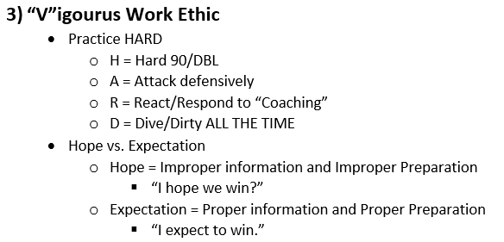
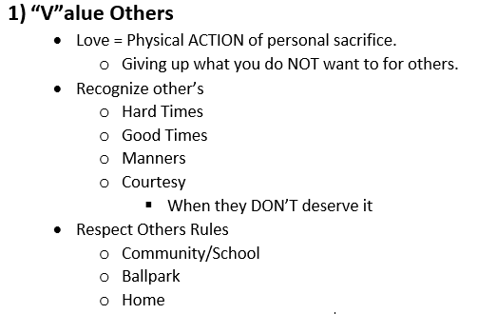
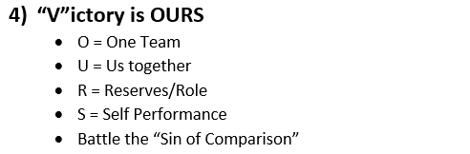
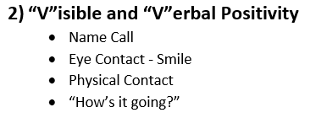
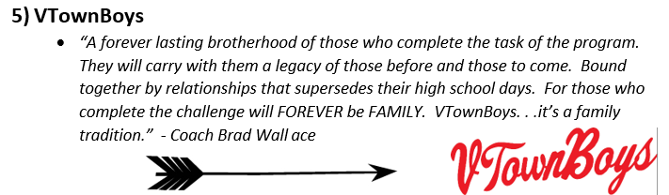
“VTownBoys Way”

Slide 4
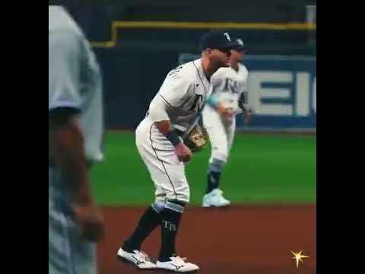
Prep
Prep
“1 - 2 - HOP”
  Start MINIMUM of TWO Steps from where you want to finish
  HOP - must happen as ball is in the “hitting zone”.
  Finish
    Arms in position to run
      Corner INF = lower
      Middle INF = Higher
    MUST BE COMFORTABLE TO BREAK

Slide 5
Fielding Technique - Corner INF
“Shuffle Tech”
    Ball hit right at us
    “1 - 2” Step
    “1 Step” = Small side step with “Throwing side” foot and fielder MUST “present the glove”
    “2 Step” = Small step towards path of the ball with “Glove side foot” and MUST arrive as the ball is being fielded
      Glove, ball, and foot should arrive at the same time.
Cone Ground Balls

Slide 6
Fielding Technique - Middle INF
“V-Cut Tech”
    Ball hit right at us
    “1 - 2 - 3” Step
    “1 Step” = 45 degree angle step with “Glove side” foot and fielder MUST “point should toward the ball”
    “2 Step” = Small step across “1 Step” towards path of the ball with “Throwing side foot” and MUST “present the glove”.
    “3 Step” = Step with “glove side foot” towards path of the ball with “Glove side foot” and MUST arrive as the ball is being fielded
      Glove, ball, and foot should arrive at the same time.
Cone Ground Balls

Slide 7
Practice Routines - Picks and “Fast Five”
Pre-Throwing
Players MUST do 1X10 of each
  One Hand
  Two Hand
  “Baby” Backhand
  Extended Backhand
  Forehand
“Fast Five”
Players MUST do 2 sets each

Slide 8
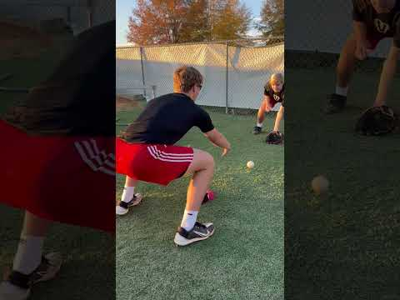
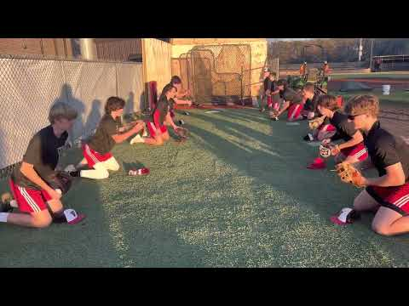
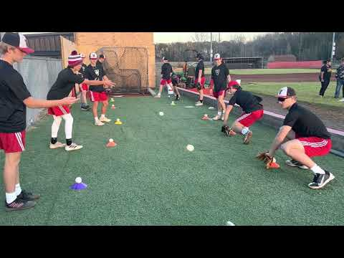
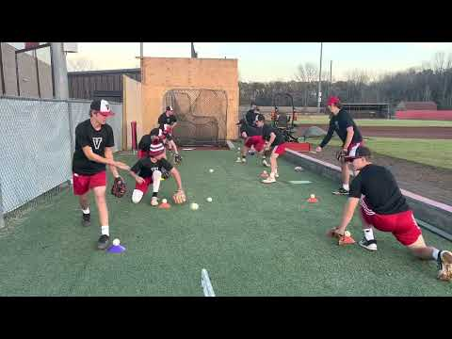
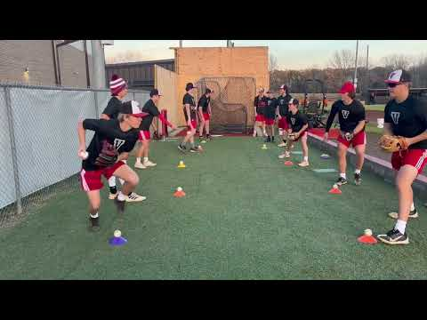
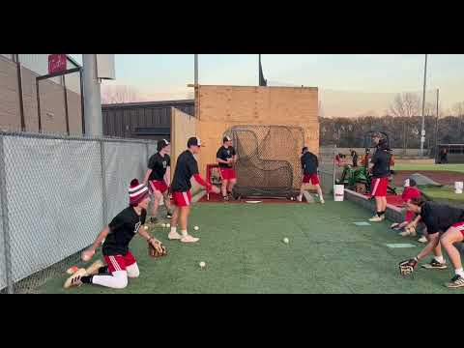
Practice Routines - Pre Throwing

Slide 9
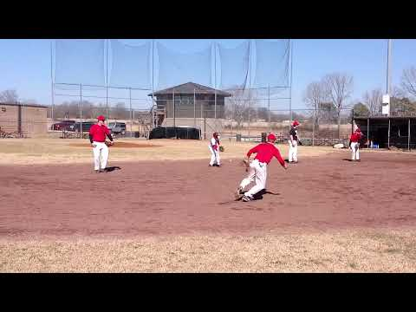
Practice Routines - “L Drill”
Backhand/Forehand Focus
  Footwork
  Short Throwing
Backhand Focus
  “Baby” Backhand
  Extended Backhand
  Hand on top of the ball.
Forehand Focus
  “Rip-it DON’T Flip-it”
    Shoulder closed
  Inside foot = Rip
  Outside foot = Follow

Slide 10
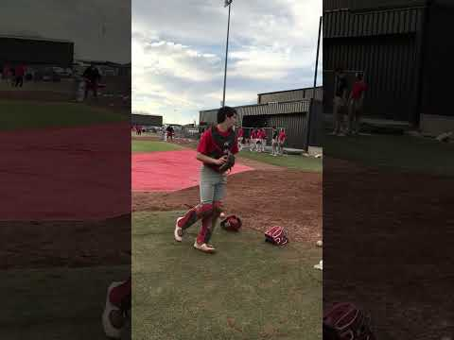
Practice Routines - Group (Cut Drill)
Outfield Cut Throws Focus
  Loud Target
  Short/Intermediate Throwing
Short Tech
  Shorter Throw for the infielder
  “Step(to the ball)-Catch-Throw”
  Find the arm slot for throw
  Corner INF ONLY
  Middle INF use as well
Long Tech
  Longer throw for the infielder
  “Step(with the ball)-Catch-Throw”
  Middle INF ONLY

Slide 11
Practice Routines - Group (Triangle Drill)
Infielding and Throwing Focus
  Moderate working to intense throwing
  Prep Steps or NO ROLL
  Misplay NO ROTATION
  Wrong roll NO ROTATION
  Plays progress to above 90 ft.
  Cone distance is 3B to cones
  Complete throwing progression.
Rounds = 3 min(5 rds = 15 min total)
  Rd 1 = 20-25 ft. “Baby” Backhand
  Rd 2 = 40-50 ft. “Fast One”
  Rd 3 = 60 -70 ft. “Extended” Backhand
  Rd 4 = 90 ft. “Regular”
  Rd 5 = 90 ft. “Slow Roller”
    Roller catches exchange throw, then runs Full speed at fielder.
    When roller catches, fielder runs full speed at roller.

Slide 12
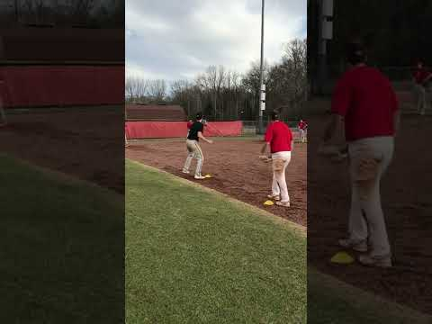
Practice Routines - Group (Triangle Drill)
“Baby” Backhand

Slide 13
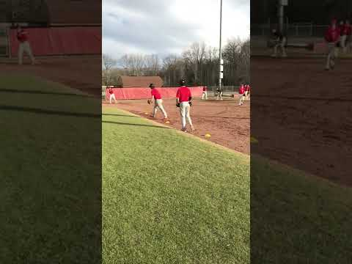
Practice Routines - Group (Triangle Drill)
“Fast One”

Slide 14
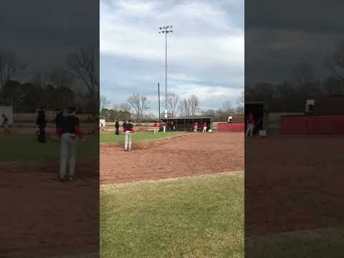
Practice Routines - Group (Triangle Drill)
“Extended” Backhand

Slide 15
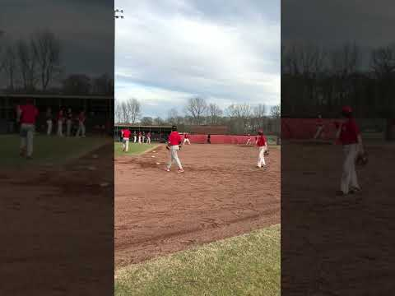
Practice Routines - Group (Triangle Drill)
“Regular”

Slide 16
Practice Routines - Group (Triangle Drill)
“Slow Roller”

Slide 17
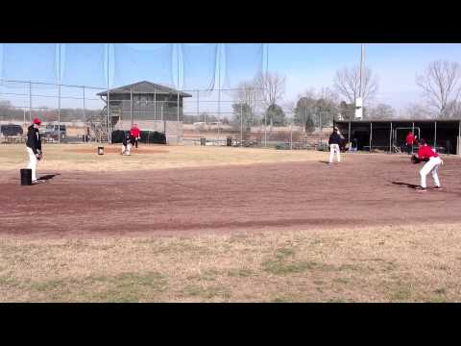
Practice Routines - Group (Bucket Feeds)
Double Play Focus
  More intense throwing
  “Feeds and Turns”
  Rounds = 1 bucket of 36 balls
    Rd 1 = 3B - 2B - 1B - Bucket
    Rd 2 = SS - 2B - 1B - Bucket
    Rd 3 = 2B - SS - 1B - Bucket
    Rd4 = 1B - SS/2B - 1B (other 1B) - Bucket

Slide 18
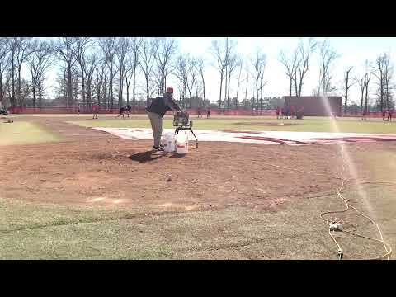
Practice Routines: Team (Round 1)
Machine Fungo (2 Man)
Hack Attack JR at home
OR Coach
  3B/2B (right side)
  SS/1B (left side)
2 rounds = 7 mins
Bucket at 1B and 2B
Rd 1
  “Left Side 2, Right Side 1”
  SS/1B feed 2B (pitcher)
  3B/2B throw 1B (1B cover)
Rd 2
  “Left Side 1, Right Side 2”
  SS/1B throw 1B (1B/pitcher cover)
  3B/2B feed 2B (pitcher)

Slide 19
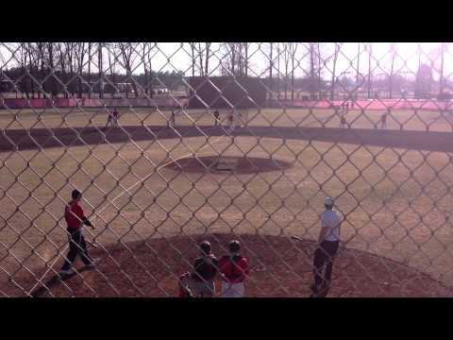
Practice Routines: Team (Round 1)
Machine Fungo (2 Man)
Hack Attack JR at home
OR Coach
  3B/2B (right side)
  SS/1B (left side)
2 rounds = 7 mins
Bucket at 1B and 2B
Rd 1
  “Left Side 2, Right Side 1”
  SS/1B feed 2B (pitcher)
  3B/2B throw 1B (1B cover)
Rd 2
  “Left Side 1, Right Side 2”
  SS/1B throw 1B (1B/pitcher cover)
  3B/2B feed 2B (pitcher)

Slide 20
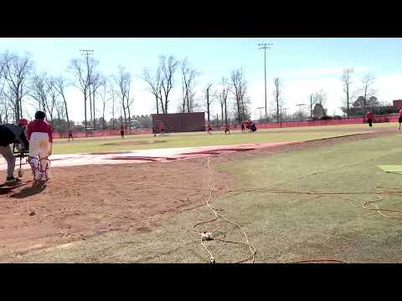
Practice Routines: Team (Round 2)
Machine Fungo (2 Man)
Hack Attack JR at home
OR Coach
  3B/2B (right side)
  SS/1B (left side)
2 rounds = 7 mins
Bucket at 1B and 2B
Rd 1
  “Left Side 2, Right Side 1”
  SS/1B feed 2B (pitcher)
  3B/2B throw 1B (1B cover)
Rd 2
  “Left Side 1, Right Side 2”
  SS/1B throw 1B (1B/pitcher cover)
  3B/2B feed 2B (pitcher)

Slide 21
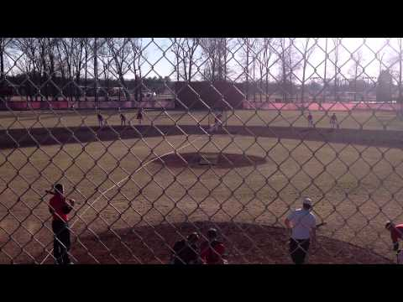
Practice Routines: Team (Round 2)
Machine Fungo (2 Man)
Hack Attack JR at home
OR Coach
  3B/2B (right side)
  SS/1B (left side)
2 rounds = 7 mins
Bucket at 1B and 2B
Rd 1
  “Left Side 2, Right Side 1”
  SS/1B feed 2B (pitcher)
  3B/2B throw 1B (1B cover)
Rd 2
  “Left Side 1, Right Side 2”
  SS/1B throw 1B (1B/pitcher cover)
  3B/2B feed 2B (pitcher)

Slide 22
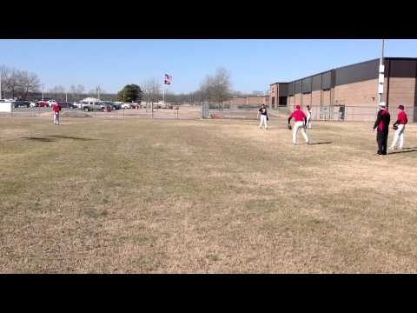
Practice Routines: Team
4 Corners Throwing
60 - 70 ft apart
All Infielders OR Infielders and Catchers
Rounds = 2-3 mins
  Shuffle
  Step-to
  Pivot
  Tags
  “Roll to Left, Throw Across”
    Regular
      Catcher Throw down
    Forehand
    Backhand
    Slow roller
      Catcher Throw down

Slide 23
Practice Routines: Team
Fungo (Routine)
2 Coaches
  3B/2B (right side)
  SS/1B (left side)
3 min rounds
  Rd 1 - INF in
    Force Home
    Tag Home
    Catcher DP
  Rd 2 - normal/pitcher on
    5-4-3, 6-3, 3-1
  Rd 3 - normal/pitcher on
    5-3, 4-6-3, 3-6-3 or 1
  Rd 4 - normal/pitcher on
    5-3(back/fore), 6-4-3, 4-3, 1-6/4-3
  Rd 5- normal/pitcher on (slow rollers)
    5-3, 6-3, 4-3, Triangle, 3-2, 1-2
    Triangle = slow between P, 2B, 1B
    1-2 = Squeeze
SS - Tag - Coach
2B - 1B
Situational Fungo
Competition with Runners
  Outfielders
  Pitchers
  Always a runner at Home
Outs vs. Runs
  Outs = 1
  Runs = 2
INFIELD IN ALL ROUNDS
3 minute rounds
  Rd 1 - runners 3B
    Less than 2 outs
  Rd 2 - runner 1B and 3B
    1 out
  Rd 3 - bases loaded
    Less than 2 outs

Slide 24
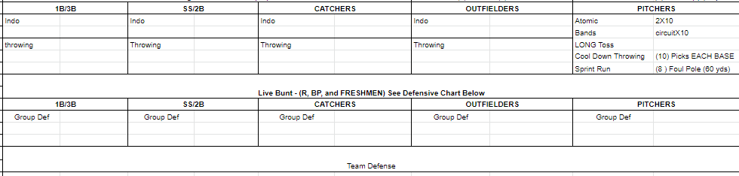
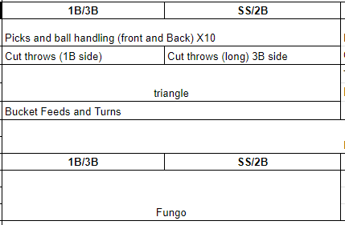
Practice Organization

