Slide 1

PROTECT THE BEAR
Nick Harlan
University of Central Arkansas
nharlan@uca.edu

Slide 2
THINGS I’M GRATEFUL FOR
GODS GRACE
PEOPLE IN MY LIFE

Slide 3
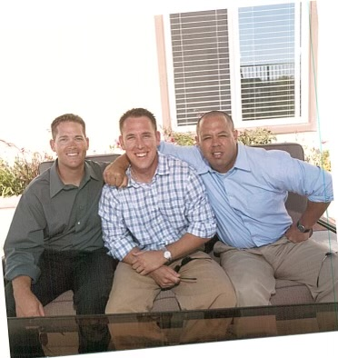
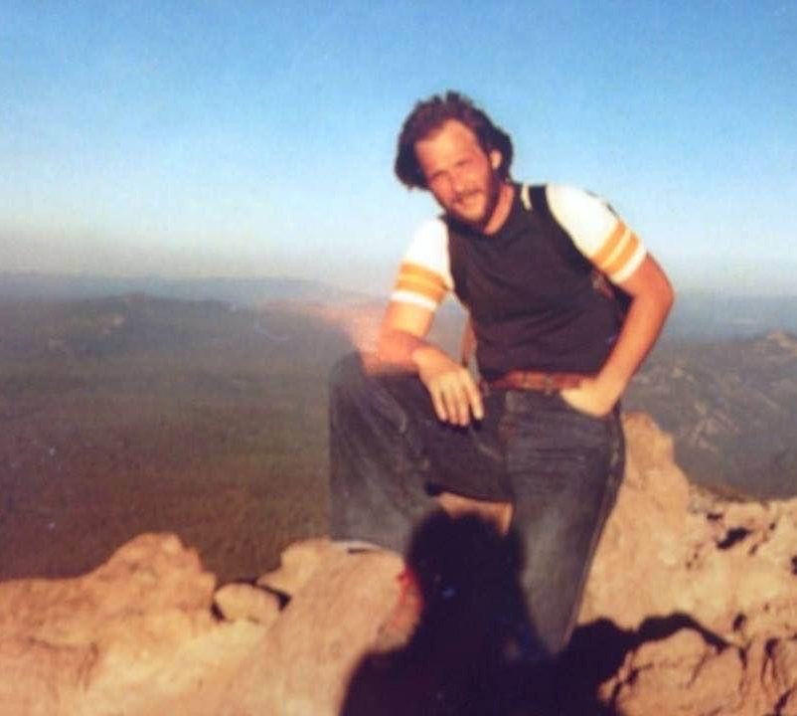
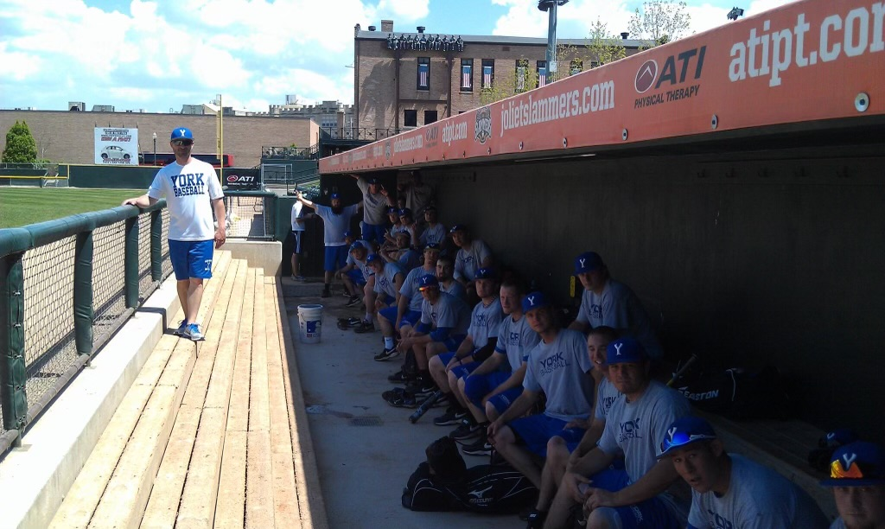
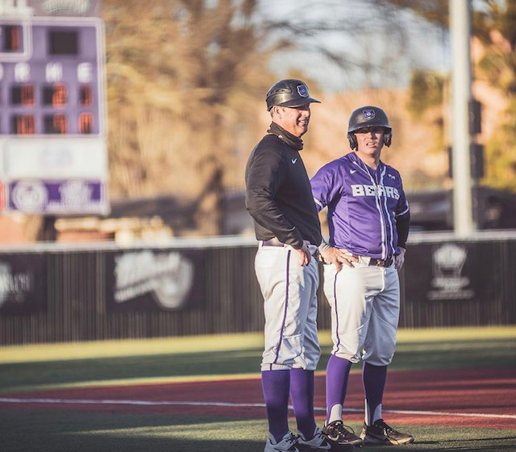
THANK YOU
COACHES IN ATTENDANCE
COACHES/PLAYERS PAST AND PRESENT
DAD
SOTO
WALTH
GUM

Slide 4
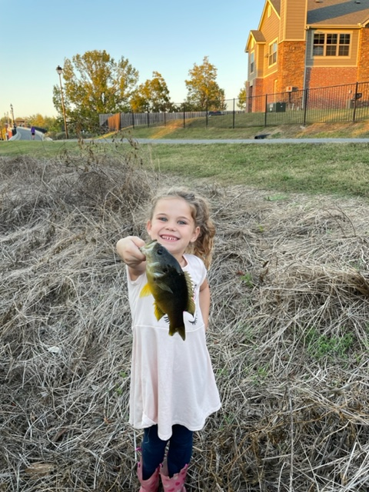
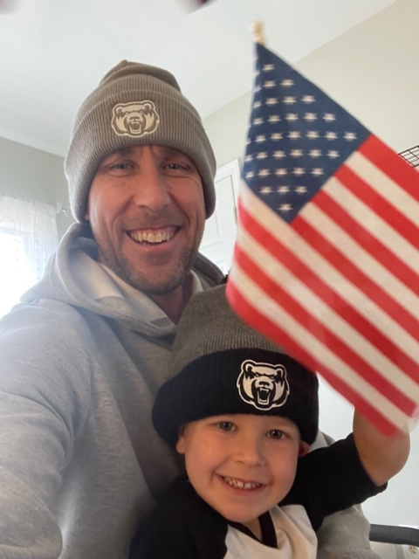
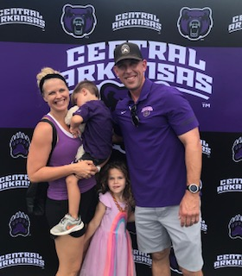
HOME TEAM

Slide 5
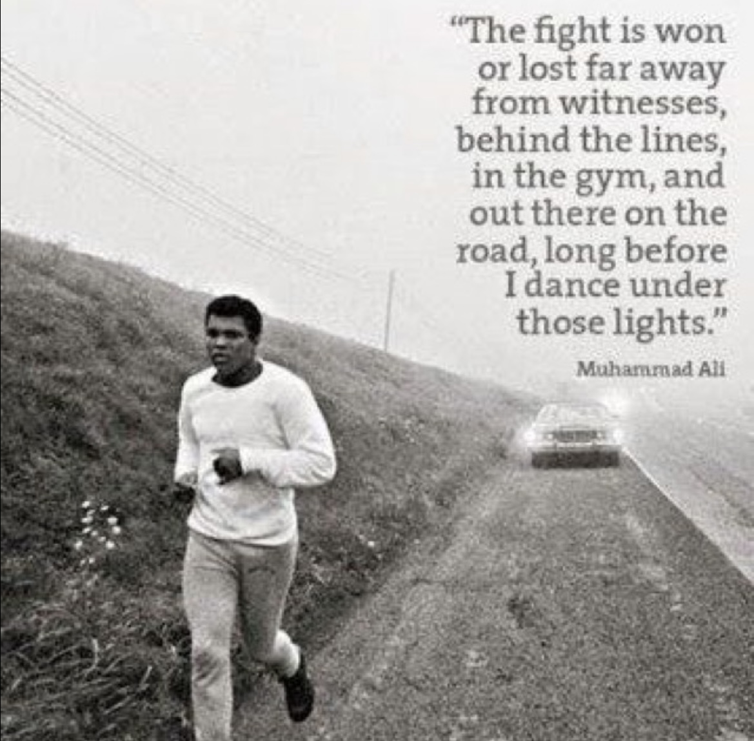
CLEAR VISION FOR TRAINING
What does environment look and feel like?
Why that environment?
How do you accomplish that environment?
Know DNA- Strength’s and weaknesses of self and staff.

Slide 6
FOUNDATION- VALUES > FEELINGS
FIGHT FOR THE R.I.G.H.T. THINGS
Respect- Self, others, game
Integrity- consistent, honest
Gratitude- positive attitude, unconditional
Humility- don’t be a know it all
Toughness- inconvenienced, recover quickly

Slide 7
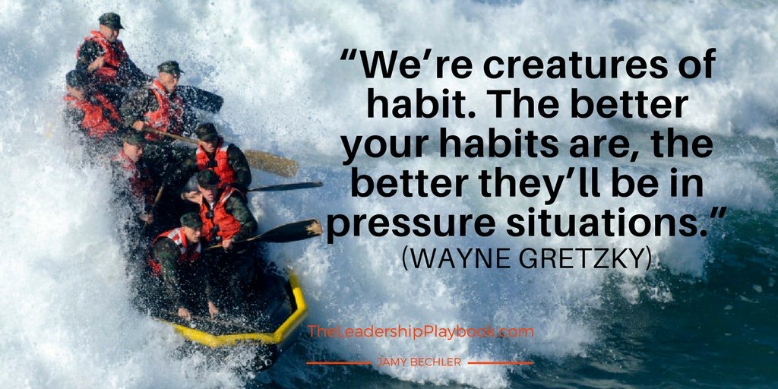
TRAINING STANDARDS
CLEAR EXPECTIONS/STANDARDS
MODEL BEHAVIOR YOU EXPECT
“YOU CANNOT TRAIN IN THE ZOO AND PERFORM IN THE JUNGLE.”
HARD WORK IS NOT PUNISHMENT
+ SYSTEM
CONSISTENCY WINS

Slide 8
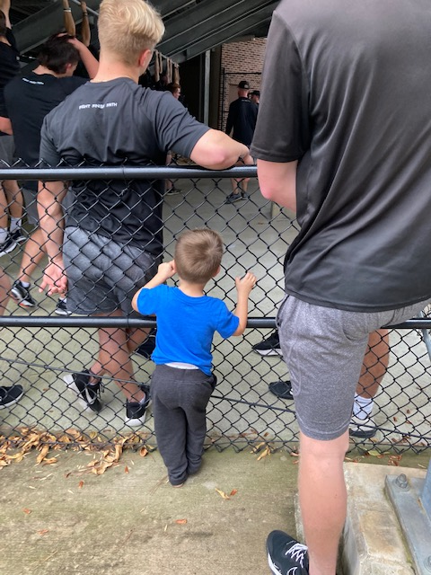
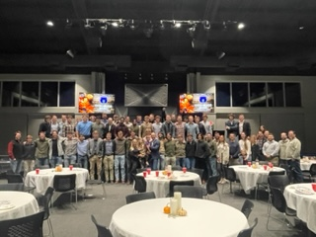
PLAYER BUY IN
(FAMILY DONE WELL, NOT PERFECT)
VALUE THEM
LOVE, RESPECT & GRACE
HUMILITY
AUTHENTIC
WORK HARD
RESPECT THEIR TIME
It’s okay to say “I made a mistake” or “I don’t know”.

Slide 9
TRAINING OBJECTIVES
NOT WHAT WE DO BUT HOW WE DO IT. (No magic drill)
NEVER MISS OPPORTUNITY TO IMPROVE.
  Organized (early, week, day, practice plan)
  Intentional (every rep matters)
  Detailed (little things make a big difference-dugout/strike outs/phones
  Patient Urgency (players must feel it)
  Connection (communication style)
  Positive (freedom)
MASTER FUNDEMENTALS VS. CHASING TRENDS
CONFRONT CONTROLLABLES/FORGIVE PHYSICAL MISTAKES
WILLINGNESS TO HOLD PLAYERS ACCOUNTABLE
  People Pleaser (portal)-They need a leader
  It takes Effort
  Conviction

Slide 10
WEEKLY PLAN
WHAT’S UP FELLAS,
HOPE EVERYONE HAD A GOOD DAY OFF. LOOK FORWARD TO SEEING EVERYONE IN THE MORNING. HERE IS THE PLAN FOR THE WEEK. ONE DAY AT A TIME!
MONDAY
6:00AM WEIGHTS
GROUP WORK
2:15 MEET IN DEN
TUESDAY
6:00AM WEIGHTS
GROUP WORK
MEET IN DEN
WEDNESDAY
OFF
THURSDAY
6:00AM WEIGHTS
OPTIONAL GROUP WORK
2:15 MEET IN DEN
3:15 FIRST STRIKE
FRIDAY
6:00AM WEIGHTS
OPTIONAL GROUP WORK
2:15 MEET IN DEN
3:15 FIRST STRIKE
SATURDAY
8:30 OPTIONAL HITTING
9:00 MEET IN DEN
10:00 FIRST STRIKE
SUNDAY
OFF

Slide 11
SAMPLE PRACTICE PLAN
PROTECT THE BEAR
2:15 MEET IN DEN
GRATITUDE VS HAPPINESS/DECIDE 1ST
2:30 ATHLETIC WARM UP
AGILITIES/LEG SWINGS/MOBILITY/+ STATIONS (SLED, HEAVY ROPE, CONE DRILL, MED BALL SLAMS)
2:45 FOCUSED THROWING PROGRAM
6 STATIONS/OPEN
DAILY VITAMINS
3:05 INDIVIDUAL DEFENSE/BASERUNNING
1ST -2ND/SLIDE AND ADVANCE
2ND-3RD/INSIDE MOVE, FAR AS YOU CAN WITHOUT GETTING PICKED
3:25 HAMMER/SEAL BATTING PRACTICE
8 MINUTE ROUNDS
4:10 TEAM DEFENSE
CUTS AND RELAYS
POP FLY COMMUNICATION
PICKS
RUNDOWNS
1ST AND 3RDS
BUNT O VS BUNT D
DOUBLE FUNGO
BANANA ROUTES
4:55 MEET IN DEN
SPOTLIGHT SESSION/CLEAN UP

Slide 12

START TOGETHER
WHAT’S IMPORTANT NOW
10-20 Minute Den (dugout) Meetings
  Teach (whiteboard)
  Culture- Environment we create everyday
  Foster pride (past players, coaches)
  Connect
  Home- Good, Bad, Ugly, Forgive, Grow
  Mental Game-Controlling self from moment to moment. (Perspective changes everything)

Slide 13
MEASURE THE MOST IMPORTANT THINGS
-WHATEVER YOU EMPHASIZE, YOU WILL IMPROVE ON.
-COMMUNICATES WHAT WE VALUE
WEIGHT ROOM/LAB
SPEED
STRENGTH
MOBILITY/FLEXIBILITY
HITTERS
STATS- QAB’S OBP, HARD CONTACT, RUNS SCORED
BAT SPEED, EXIT VELO
PITCHERS
FPS %, TOTAL K %, 3 BALL COUNTS, K’S
+ RESPONSE
EXPLOSIVE MOVEMENTS (INTENT)
DEFENSE/BASERUNNING
TIME TO FIRST- UNDER 4 SECONDS
TIME TO BALL-CUT IT OFF
TIME TO PLATE- 3 SECONDS

Slide 14
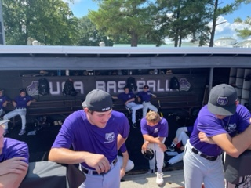
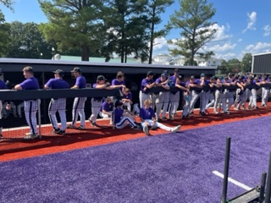
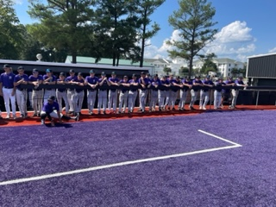
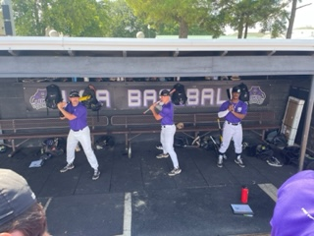
WALK THROUGH/ROLE PLAY

Slide 15
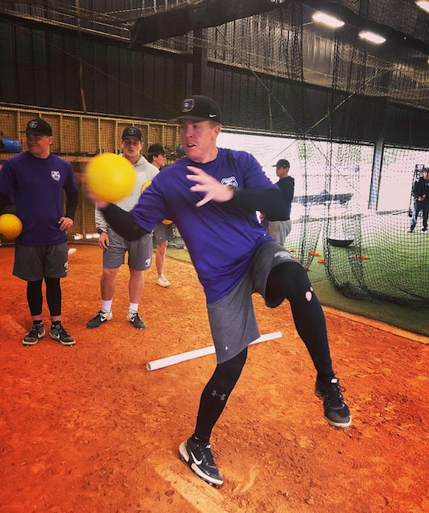
ATHLETIC WARMUP
15-20 MINUTES
MOVEMENT PATTERNS
CORE TEMPERATURE
GET MIND RIGHT
CREATIVE- Concepts of Teaching May Change. Core Values Remain The Same.

Slide 16
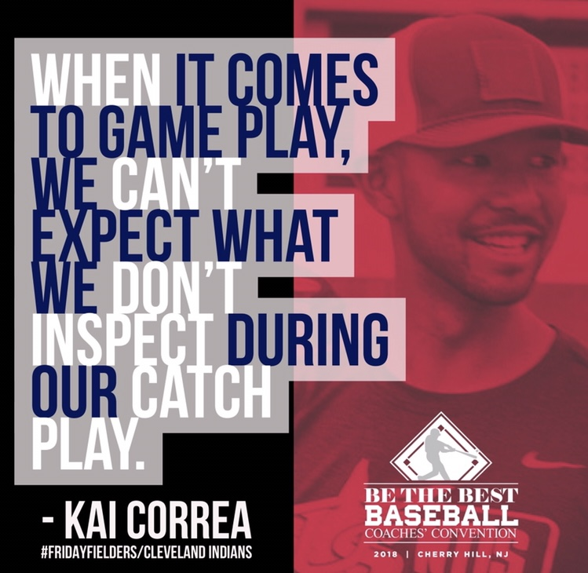
FOCUSED THROWING PROGRAM
10-20 MINUTES
QUIET CATCH VS. CLOWN CATCH
WIN OR LOSE PLAYING CATCH (Just play catch)
ACCOUNTABILITY & OWNERSHIP (WHAT WE TOLERATE, WE ENCOURAGE)
PRESSURE (BE PRESENT, ENGAGE, PROXIMITY)
SERVAIS- “ANYONE CAN BE A GOOD DEFENDER.”

Slide 17
FOCUSED THROWING PROGRAM
1-2 MINUTE STATIONS
10’ DART
20’ FEET IN CRETE
30’ OPEN ARM SLOTS
45’ POSITION SPECIFIC-MARSHALL/QUICK FEET
60’ POSITION SPECIFIC-GROUND BALL/STRETCH
70’ POSITION SPECIFIC-RELAY, FLY BALL
90’ POSITION SPECIFIC-PICK AND TAG, PICK CUT UP, 1 HOP
120’ OPEN
DAILY VITAMINS
OZZIES
ATHLETIC THROWS
BALL HANDLING DRILLS
QUICK CATCH
JETERS

Slide 18
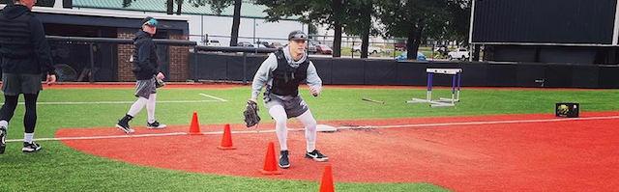
15- 20 MINUTES
SPECIFIC- (EX. DOUBLE PLAY, SLOW ROLLERS) (EX. BID, LEFTY READS, HARD 90’/TURNS, SPRINT THROUGH HOME, INSIDE TURN, SLIDE & ADVANCE.)
(EXAMPLE- BLOCKING, RECEIVING)
(EXAMPLE- CLOSE THE GAP ON GROUND BALL TO OUTFIELD)
INDIVIDUAL D / BASERUNNING
WHAT IS IMPORTANT TO YOU?

Slide 19
BATTING PRACTICE
INTENT-BARRELL CONTROL, SITUATIONAL HITTING
BULLPENS
INTENT, COMMAND, DNA
45 MIN- 1 HOUR
STOP WATCH
DEFENSE, DEFENSE, BASERUNNING, BUNT, LIVE
-Defense live reps
-Baserunning (vest), Defense
-Bunt (Mad in game)
VARIETY
- HAMMER BP (Weighted bats, gun)
- COMPETITION BP
- SEAL BP
- CHAMPIONSHIP BP
45 MIN – 1 HOUR
TECH/PITCHABILITY/COMPETING
VARIETY
-DNA PENS
- SEAL PENS
- GAME MOUND
-RAPSODO PENS
FLUSH

Slide 20
CHAMPIONSHIP BP
5 GROUPS
DEFENSE
DEFENSE
DEFENSE
DEFENSE
LIVE
ROUNDS-9 MIN
1- HIT BEHIND RUNNER/IF IN
2- LOW IN MIDDLE/HALF WAY
3- RUNNER 3RD LESS THAN 2/STRAIGHT UP 1
4- LET IT EAT- GAP TO GAP/DP’S
5- LET IT EAT- DRIVE THROUGH CF WALL/DP’S
POINTS OF EMPHASIS
FULL SPEED
RECOVER AND GO
FINISH EVERY PLAY
CELEBRATE GOOD DEFENSE
GIVE DEFENSE TIME
CATCHERS PLAY IT OFF L SCREEN
HARD 90’ FIRST TWO ROUNDS/HARD 10’ ON
SEAL OR HAMMER BP
5 GROUPS
DEFENSE
DEFENSE
DEFENSE
BASERUNNING
LIVE
ROUNDS-8 MIN
1- LET IT EAT-POWER GROUND BALL-BACK SIDE
2- LET IT EAT- LOW AND IN THE MIDDLE
3-LET IT EAT- GAP TO GAP
4- LET IT EAT- PULL SIDE
5- LET IT EAT- DRIVE THROUGH CF WALL
POINTS OF EMPHASIS
5 PULL UPS BETWEEN ROUNDS
WEIGHTED BAT-SPECIFIC ROUNDS
RADAR GUN-EXIT SPEED
VEST ON BASE RUNNERS
BODY LANGUAGE

Slide 21
DNA PENS
30-40 PITCHES
STRETCH/WINDUP
2 SETS OF 15-20
POINTS OF EMPHASIS
ESTABLISH GLOVE SIDE FB
ESTABLISH BEST SECONDARY PITCH
SETS
SETS OF 3
GET AHEAD
EXPAND ZONE
PUT AWAY
KNOW HITTER AND ATTACK PLAN
USE YOUR DNA
FORCE DECISION MAKING
COMPETITION/SEAL PEN
30-40 PITCHES
STRETCH/WIND UP
2 SETS OF 15-20
POINTS OF EMPAHASIS
CONTROL HEART RATE
COMPETE-FIND A WAY
SETS
SCRIPTED
EMPHASIS ON COMMAND
HITS AND MISSES
HIT SPOT %

Slide 22
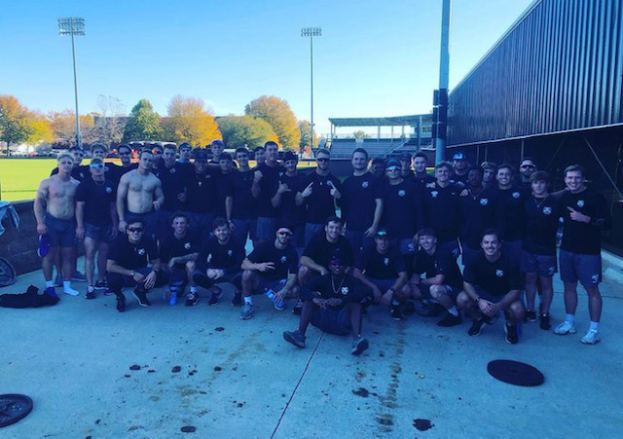
FINISH TOGETHER-TEAM DRILLS
MOST IMPORTANT THING ABOUT TEAM DEFENSE = TEAM
20- 30 MINUTES
CONTROLLED CHAOS
LESS IS MORE
QUICK-KEEP ATTENTION
FUNDAMENTALS
NO PANIC- RECOVER FROM ANYTHING
MOVE ON.COM
ONE PLAY/ ONE MISTAKE- DOES NOT DEFINE US
POP FLY COMMUNICATION VS 1ST AND 3RD
BANANA ROUTES

Slide 23
DOUBLE FUNGO ROUTINE
INFIELD IN, SHOOT EM DOWN AT THE PLATE (1 FUNGO HITTER)
PITCHER THROWS TO THE PLATE….6-5, 2-4, 3-1
PITCHER THROWS TO THE PLATE….2-5, 6-4-3, 1-3 SHORT BAG
PITCHER THROWS TO THE PLATE….2-3, SHORT BAG, 4-6-3, 1-5 BUNT
NO PITCHER THROWING….5-4-3 AND 6-4-3, 1-2-3 SHORT BAG
NO PITCHER THROWING….5-2-3 SHORTBAG, 16/4-3
NO PITCHER THROWING….3-6-1, 5-3, SLOW ROLLER TO SHORT BAG
ONE FUNGO HITTER, SLOW ROLLERS/UNASSISTED TO EVERYONE….NO PITCHER

Slide 24
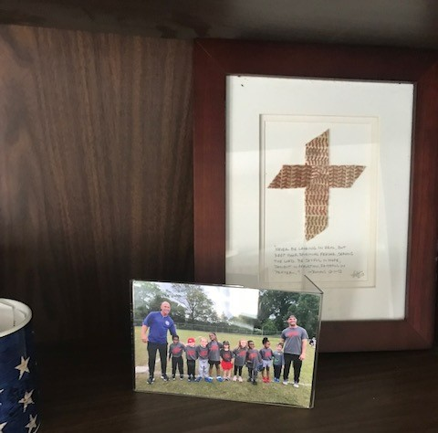
IDENTITY NOT IN BASEBALL =
FREEDOM
nharlan@uca.edu

